Slide 1
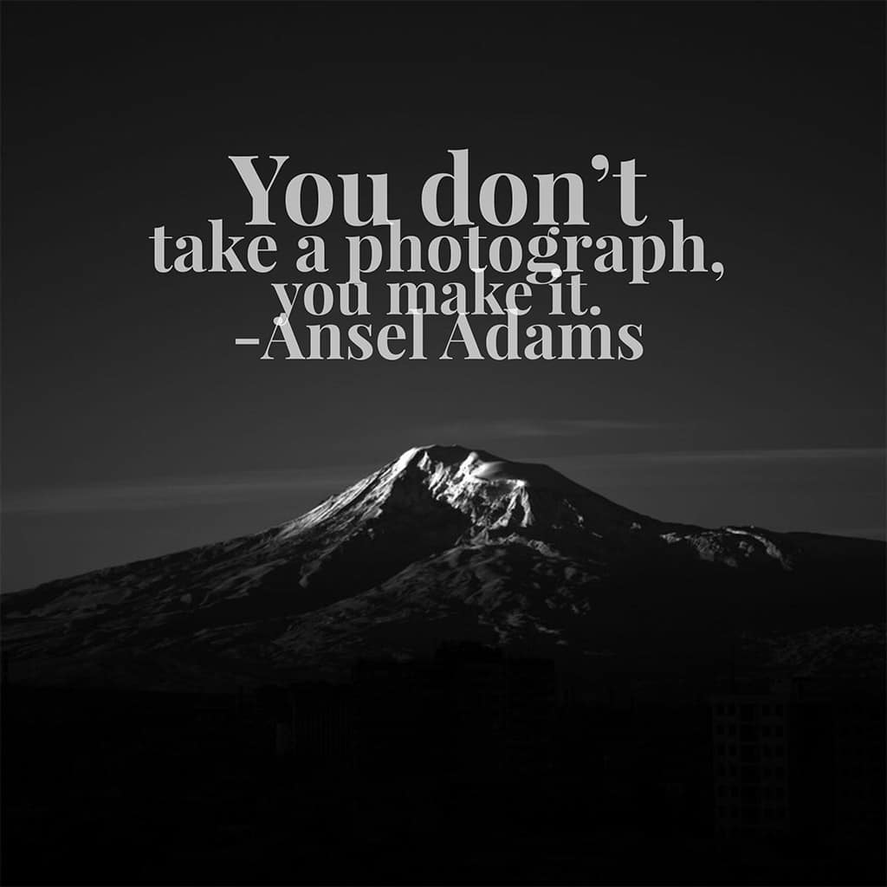
Pick up a photography packet at the front table
No painting today….

Slide 2
Composition & Photography

Slide 3
Balance
Symmetry
Creates order
Can lack movement
Asymmetry
Try for more interesting images!

Slide 4
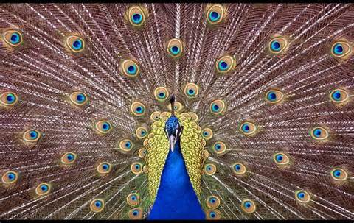

Slide 5
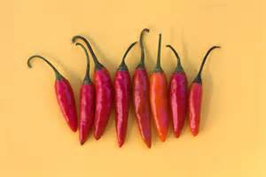

Slide 6
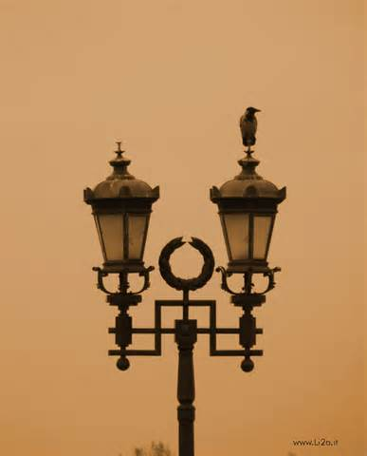

Slide 7
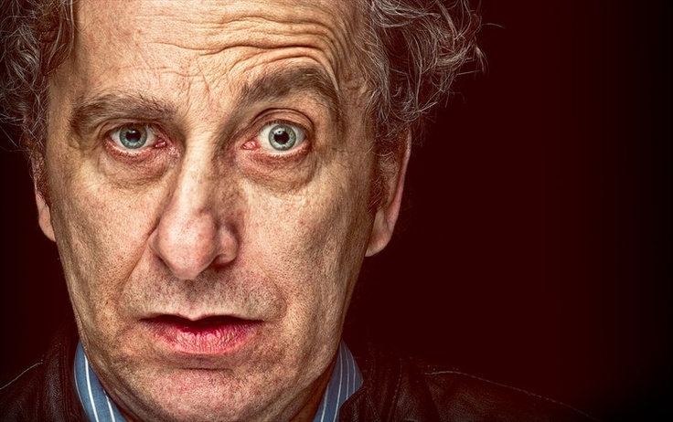

Slide 8
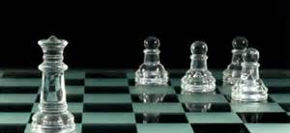

Slide 9
Rule of Thirds
*Creates OFF-CENTER emphasis

Slide 11
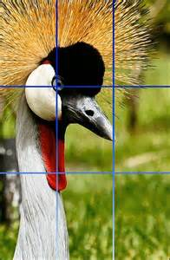

Slide 12
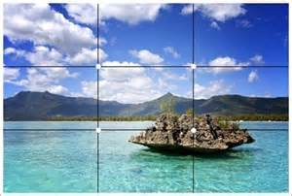

Slide 13
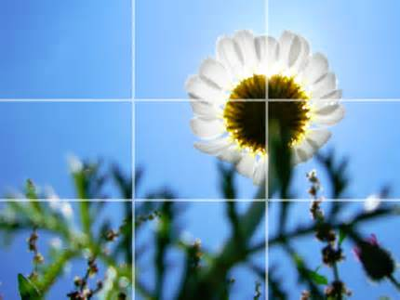

Slide 14
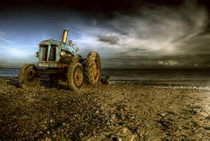

Slide 15
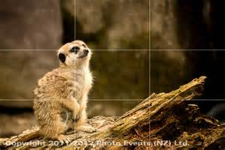

Slide 16
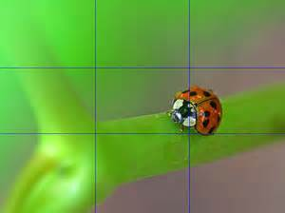

Slide 17
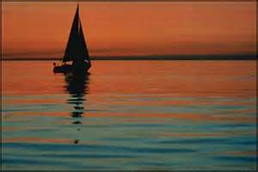
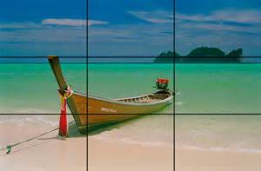
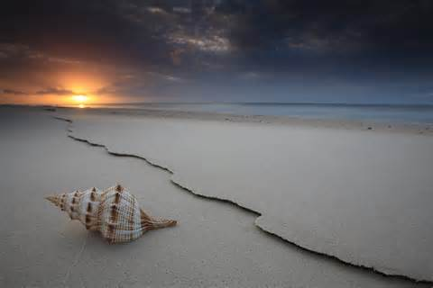
Horizon Line
Try using either top 1/3 or bottom 1/3!

Slide 18
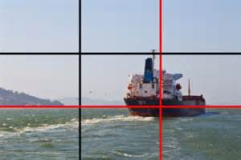
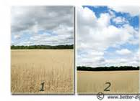

Slide 19
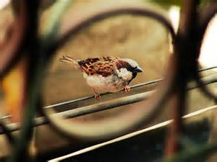
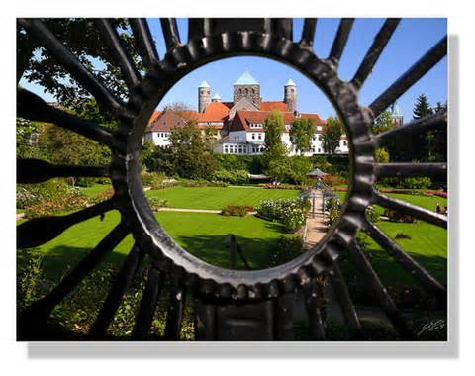
FRAMING
Compositional technique used to
DRAW ATTENTION
to the main subject

Slide 20
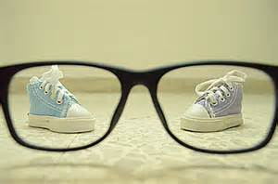
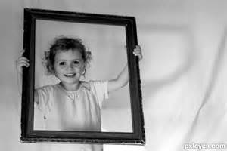
Positioned around the SUBJECT

Slide 21
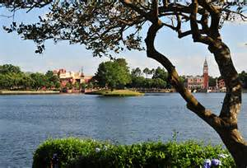
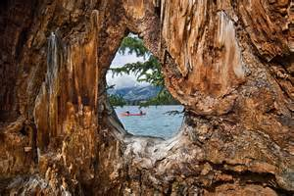
Takes away distracting details

Slide 22
ANGLE OF VIEW (viewpoint)
Eye Level (looking straight on)
Below Eye Level (looking up)
Above Eye Level (looking down)

Slide 23
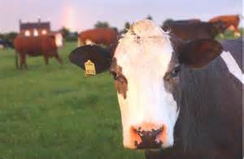
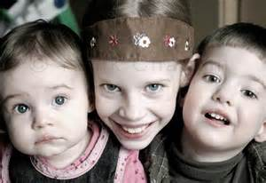
1. Eye level (looking straight on)

Slide 24
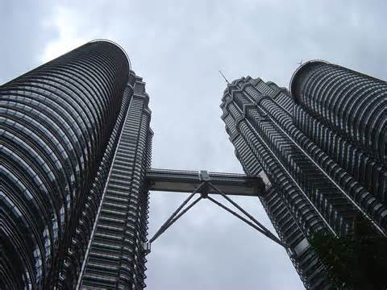
2. Below Eye Level (looking up)
AKA: worm’s eye view

Slide 26
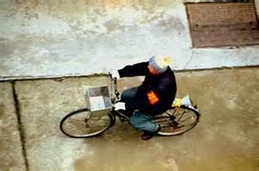
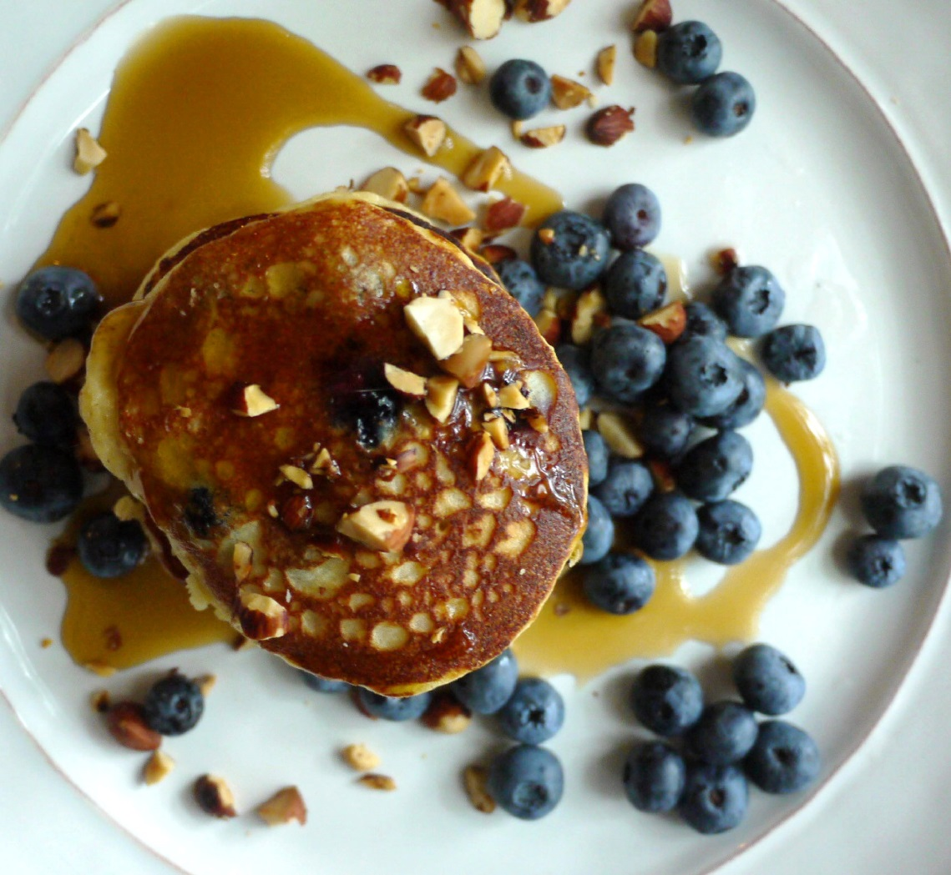
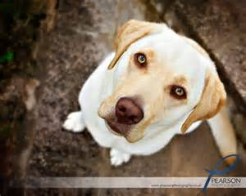
3. Above Eye Level (looking down)
AKA: Bird’s eye view

Slide 27
Other things to think about:
Direction
(portrait or landscape)
or
The background
if distracting → crop out/zoom in
→move to another spot

Slide 28
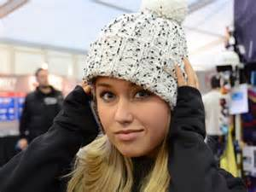
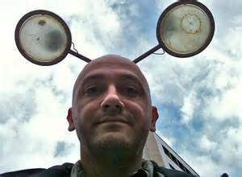
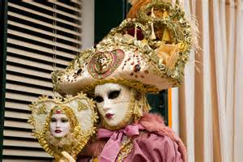

Slide 29
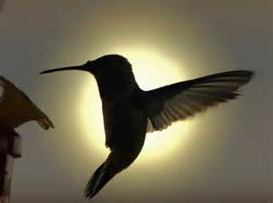
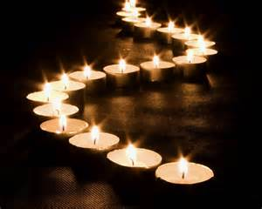
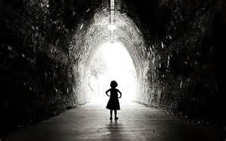
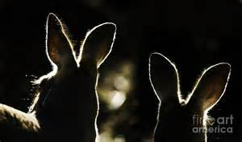
…also LIGHTING

Slide 30
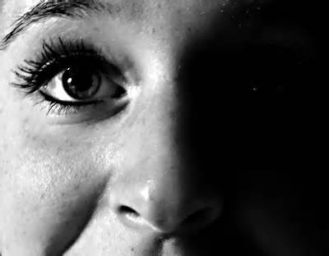
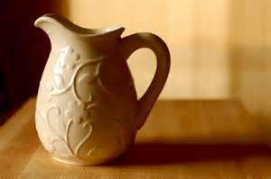
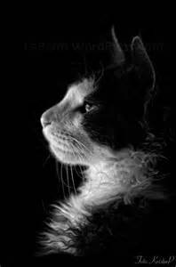
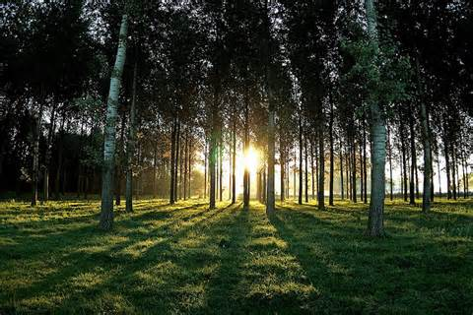

Slide 31
FOCAL POINT
Center point of interest
What the viewer’s eye SEES first
Used to capture the viewer’s attention
Can be ANYTHING!

Slide 32
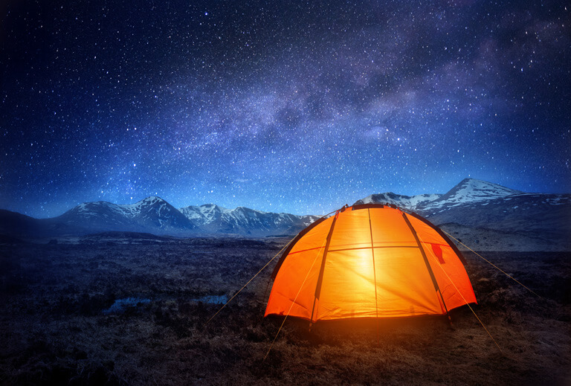

Slide 33
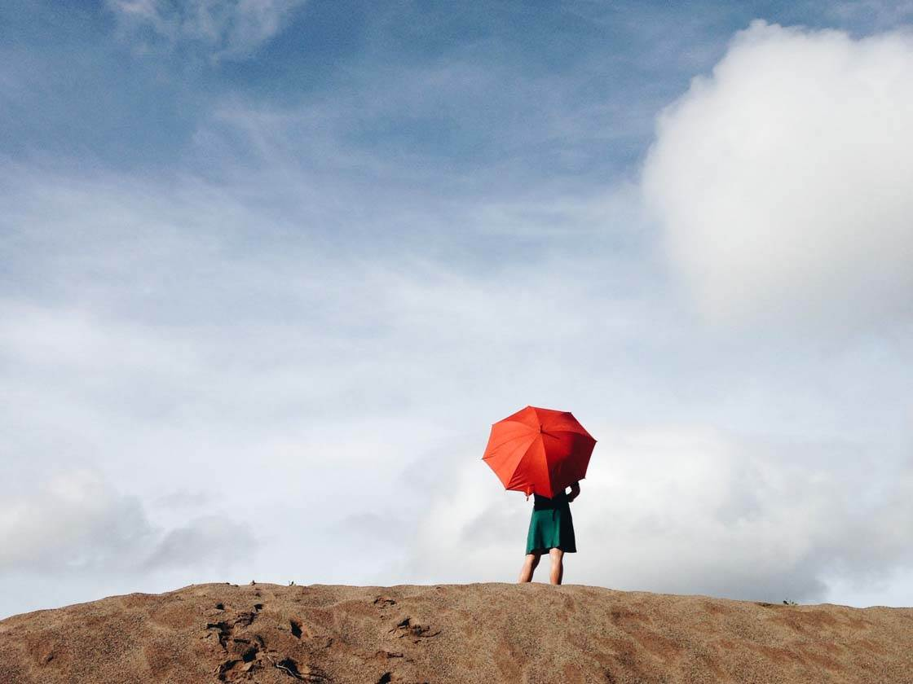

Slide 35
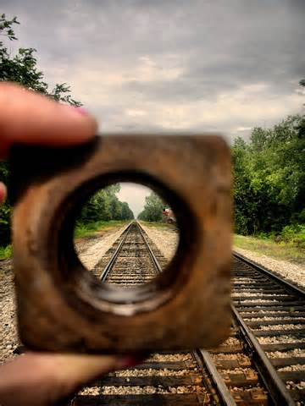

Slide 36
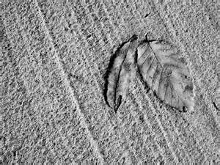

Slide 37
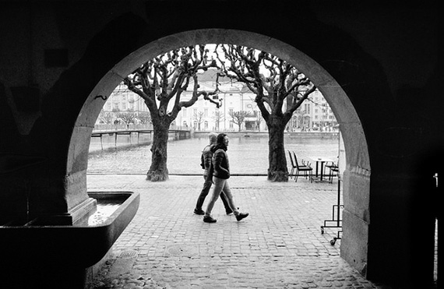

Slide 38
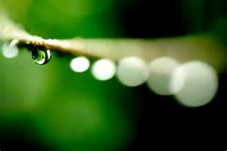

Slide 39
Ways to ENHANCE your FOCAL POINT

Slide 40
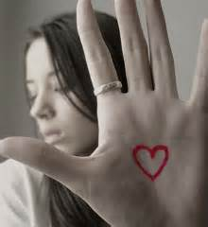
POSITION
Placing it in
a prominent area
(ex. Rule of Thirds)

Slide 41
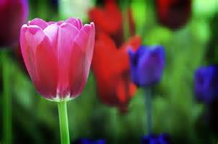
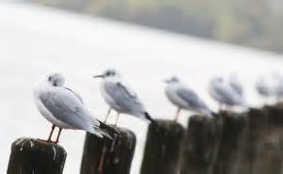
2. FOCUS
Have background be out of focus
(aperture—f-Stop—depth of field)
*****MAKE SURE ENTIRE IMAGE IS NOT BLURRY!!

Slide 42
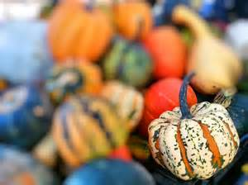

Slide 43
3.BLUR
Background blurred to show motion
(shutter speed)

Slide 44
*****MAKE SURE ENTIRE IMAGE IS NOT BLURRY!!

Slide 45
4.SIZE
Make focal point large (or small!)

Slide 46
5.COLOR
Use contrasting colors(or different)to set it apart

Slide 47
--or use COLOR SPLASH in Photoshop

Slide 48
6.SHAPE
Repetition of similar items can make a different form/shape stand out

Slide 49
PATTERN (repetition without a focal point)

Slide 50
Illustrative
What story can you tell without the use of words?

Slide 53
TRIPTYCHS

Slide 58
COLOR POP

Slide 61
Landscape images…

Slide 62
Turn in best image

